Slide 1
Welcome
www.ResourceFacilitationRTC.com

Slide 2
October 9-10, 2019 Indianapolis | IU Health Neuroscience Center
Announcement
The 3rd Annual RHI Brain Injury & Resource Facilitation Conference

Slide 3
Conference Topics include:
Guest Speaker: State Health Commissioner, Dr. Christina Box
Common Medical and Physical Comorbidities after Brain Injury
Brain Injury as a Chronic Condition
Brain Injury Resource Fair
Awards Luncheon
The Future of Brain Injury in Indiana….and more!

Slide 4
Learn from leading experts in the field of brain injury
Exhibit at the Resource Fair
Sponsor and be recognized for your support and receive many fantastic benefits
Earn continuing education credits at no additional cost.
Experience a community of like-minded individuals from all over the State of Indiana working to improve and promote the collaboration of community resource providers.

Slide 5
Register online to attend, sponsor and/or exhibit https://www.resourcefacilitationrtc.com/events For more information, contact: Wendy Waldman at 317.329.2235 or wendy.waldman@rhin.com

Slide 6
We hope to see you in October!

Slide 7
Indiana Needs & Resource Assessment Survey
Jeremy Funk

Slide 8
Updates:
The survey was modified to include the issues discussed in our last meeting.
Additional logic was added to help gather patient demographic data.
Further thought was devoted towards clarity in survey groups.

Slide 9
Special Acknowledgement:
Angela White-Randolph provided incredible insights on how to improve the survey!

Slide 10
Preliminary Survey Results
Survey Launched: April 15, 2019
Surveys Collected: 149 unique Individuals
Average Time: 4 minutes 7 seconds
On pace to meet survey target (N=600)
Survey Link: https://www.surveymonkey.com/r/IndianaTBISurvey

Slide 11
Preliminary Survey Results
We have modified our dissemination plan in
hopes to improve patient and Caregiver response.
- RHI waiting room promotions
BIAI social media
Surveying support group attendants
Does the Advisory Board suggestions for recruitment
within these demographics?
Survey Link: https://www.surveymonkey.com/r/IndianaTBISurvey

Slide 12
Preliminary Survey Results
Any additional questions, comments, or suggestions for the survey?
Survey Link: https://www.surveymonkey.com/r/IndianaTBISurvey

Slide 13
ACL Resource Facilitation Research Update and Clinical Case Study
RHI Research & Clinical Team
Devan Parrott, PhD
Rehabilitation Hospital of Indiana
Lance Trexler, PhD, HSPP, FACRM
Rehabilitation Hospital of Indiana
Laura Trexler, OTR, CBIS
Rehabilitation Hospital of Indiana

Slide 14
Case Study

Slide 15
ACL RF CASE STUDY TBI is a risk factor for opioid misuse and overdose, substance abuse, psychiatric difficulties, involvement with the criminal justice system, and additional TBI/ABI

Slide 16
ACL Client TBI-ABI History
Young man, high school graduate, sales associate at a clothing store
Past medical history:
loss of consciousness (LOC) at age16 from football injury (LOC at <1 min per client)
multiple, repeated impacts to head as football player (ages 10 – 18) w/reports of feeling dazed and confused,
suicide attempt at age 19, using blood pressure medication (LOC unknown),
overdose on Heroin at age 23 - stopped breathing for 5 min. (LOC), per client report
multiple MVA’s, some w/LOC (unknown duration), multiple fractures, persisting pain, reduced motion in shoulders, back, pelvis and persisting headaches
Client reports history of rapid mood changes, irritability, impulsivity and reduced initiation

Slide 17
History of Substance Abuse
Sports injury at age18, treated with opioids, then became addicted
Substance Use Treatment History
Fairbanks - 30 days, relapse (opioids, Heroin, pain killers) (18 y/o)
Initiated Suboxone
Psychostimulant abuse (prescribed for ADD)
Rehabilitation in GA - 42 days → Sober living in Fla. w/discharge due to relapse (19 y/o)
Sober for additional 2 months
Initiated Heroin and alcohol use
DUI led him back into Sober Living (23 y/o)
Relapse and overdosed
Treatment in MI, d/c to home w/relapse (23 y/o)
Back into Sober Living (24 y/o); sober for 3 months

Slide 18
Criminal History
At 19 y/o Felony charge for distribution of obscene material.
15 months in jail before convicted of crime; 8 years were
suspended w/5 years of probation.
At 23 y/o DUI charge post motor vehicle accident; probation violation

Slide 19
Most Recent Injury
March 4, 2019 client received unpleasant news at a Parole hearing, jumped off a balcony, fell 20 feet. Age: 24
Unresponsive for several minutes followed by seizure-like activity
Sustained TBI w/LOC and sustained a right temporal hematoma
Multiple fractures: cranial fractures, Rt. shoulder fracture, fractured ribs on Rt., fractures of the spine (cervical and thoracic)
Rt. Pulmonary lacerations/contusion, Rt. Pneumothorax
Hospital Glasgow Coma Scale scores - 12,9,13 (mild to moderate BI)

Slide 20
ACL Resource Facilitation (RF)
RF Intake 4/10/19
Client Strengths: dedicated, strong, good sense of humor, willing to do what is asked, reliable on the job, a people person
Client Goals | Support Person’s Goals for Client
Return to Work | Son to be successful
Get Driver’s License re-instated | To not be an addict
Attend counseling that will help | To get on a good path
Learn to abstain from alcohol and drugs

Slide 21
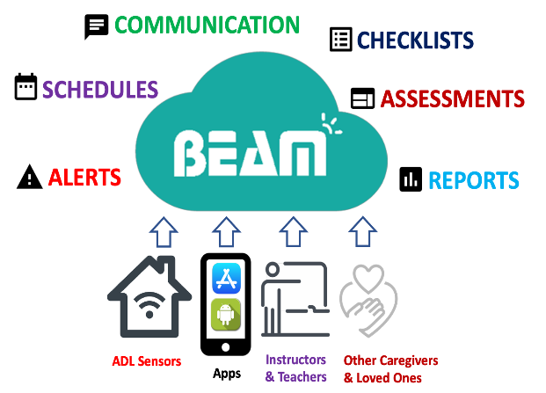
Testing Completed at RF Intake
Brief Neuropsychological testing
Additional Testing via MyBrain© on BEAM
Pain
Mood
Opioid use
Anger
Difficulties controlling mood and behavior
Substance use
Sleep
Cognitive Impairment
Level of Disability
Social Isolation

Slide 22
Hospital vs ACL RF Treatment
Recommendations

Slide 23
Recommendations – Methodist Hospital Discharge (3/12/19) | Recommendations Made by ACL RF Team
Admission to Community Hospital North Behavioral Health (3/12/19 to 3/14/19) | Risk Stratification Results: High Risk
Physical Therapy 2 times a week | RF contact and team case conferences at a minimum of every 2 weeks
Follow up with Primary Care Physician (PCP) | Follow up with PCP
Follow up with Orthopedic Physician | Consultation with Psychiatry, mental health care, ongoing counseling
Follow up with Spinal Surgery Physician | Neuropsychological Evaluation, Brain Injury Therapies, Brain Injury Coping Skills Group, Post-Concussion Group
Referral to Pain Management Physician | Follow up w/Pain Management Specialist

Slide 24
Hospital Recommendations Continued | ACL RF Facilitated Recommendations - continued
 | Addiction Services Follow-up
 | Functional Capacity Evaluation
 | Referral to Vocational Rehabilitation
 | Explore Transportation Alternatives
 | Explore Recreation/leisure Options
 | Attend Brain Injury Support Group
 | RF Team to offer BI Education to Partners in Correctional System: Prosecutor, Parole Officer, etc.

Slide 25
Hospital Recommendations | ACL RF Facilitated Recommendations - continued Surveillance and Ongoing Assessments via BEAM MyBrain©
 | Monitoring client every 2 weeks (assessments on Kindle): Pain Mood Substance Use Self-efficacy for managing emotions
 | Monthly monitoring (assessments on Kindle): Opioid use Anger Cognitive impairment Level of disability Social isolation
 | Intervention Strategies delivered on Kindle– scheduled & on demand Clear Picture HALT New Me Mindfulness for Anxiety and Stress Mindfulness for Depression MyBRAIN Now

Slide 26
Summary
TBI is a risk factor for substance abuse, involvement with criminal justice system and subsequent TBI or ABI, among other things….
Management of TBI from only one silo (e.g., health care, mental health and substance abuse, vocational, etc. .) is ineffective.
The human, social, and financial consequences are much more expensive than what TBI specific proactive management would be.

Slide 27
Task Force Updates ACL Hill Day Update Michael Clements Consumer Task Force

Slide 28
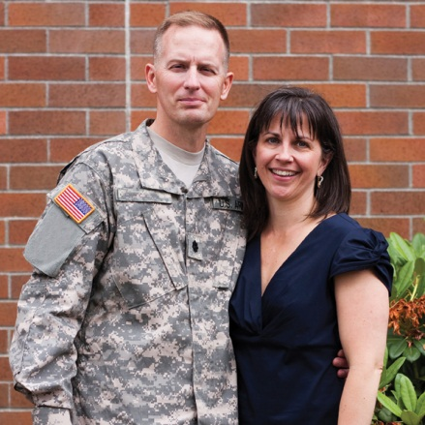
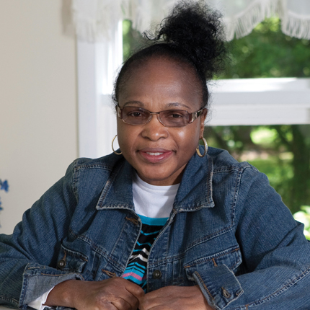
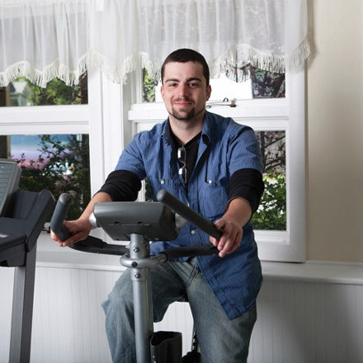
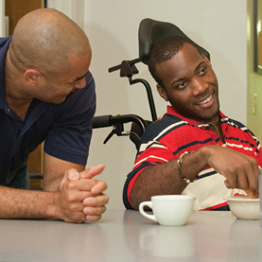
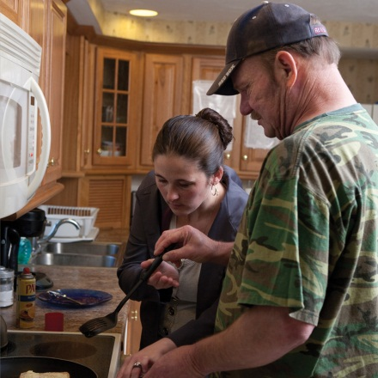
Evidenced-Based Outcomes Gordon J. Horn, PhD Deputy Director National Analytics & Outcomes NeuroRestorative

Slide 29
Introduction
Outcomes
Treatment
Measurement
Efficacy
Translation

Slide 30
Outcomes
Outcomes can be complex and broad. The key metrics can include outcome measurement of a process or program effectiveness. Outcomes can also incorporate quality assurance and improvement, along with understanding interactions with multiple types of data sets (e.g., program outcome, cost, and referral patterns, etc.).
The primary focus of any outcomes is using reliable and valid measurement to provide evidence-based modeling. In addition, translation of the data should be continuous rather than expecting static measurement. When these methods are met, then large data sets provide incredible sources of information to predict, correct, and change current practices in healthcare.
The following information is provided as a comprehensive review of neurological rehabilitation outcomes at the post-hospital level of care.

Slide 31
Treatment
There are multiple types and levels of care. The following are examples within the continuum of care in neurological rehabilitation.
Hospital Level (Inpatient) – only accounts for approximately 10% of recovery
Intensive Care and Acute Care – Stability of neurological condition
Acute Inpatient Rehabilitation Facility (IRF)
Post-Hospital Level (Inpatient-Community Residential) *
Skilled Nursing Facility Care (SNF) – may include Minimally Conscious Disorders
Post-hospital rehabilitation Care (PHR)
Nursing Home Care (NH)
Non-Residential Care *
Day Treatment – coordinated care with PT, OT, SP, Neuropsychology, Counseling
Outpatient – Single service or uncoordinated care (combination of 1-2 services)
Home & Community – in home application of skills (self-care, home skills, money)
* Combined results in 90% of recovery

Slide 32
Treatment Efficacy
The efficacy of care has to be demonstrated to show that gains can be made.
Considerations of Efficacy…
Reduce disability over time.
Application of skills to real-world context.
Improved functional outcomes for community living.
For those with long-term care needs, provide a healthy and safe environment with focus on producing medical, physical, cognitive, and emotional stability.
Prevention of decline through the aging process.
Question: Does it work?
Answer: YES. Findings are clinically and statistically significant.

Slide 33
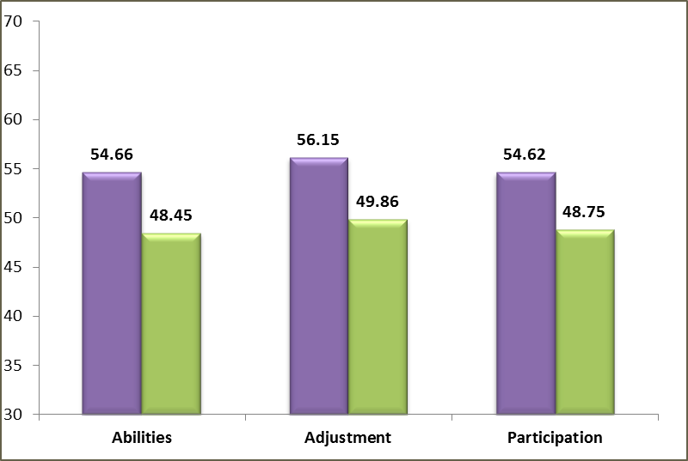
Treatment Efficacy
Reduce disability over time. This graph shows that lower scores are achieved across all types of treatment at the post-hospital level of care (N = 3,565).
Program Types:
Residential
Neurorehabilitation
Neurobehavioral
Supported Living
Adolescent Intensive
Non-Residential
Day Treatment
Outpatient
Home & Community
Abilities [t(3564) = 45.1, p<.001]; Adjustment [t(3564) = 41.7, p<.001]; Participation [t(3564) = 47.9, p<.001].

Slide 34
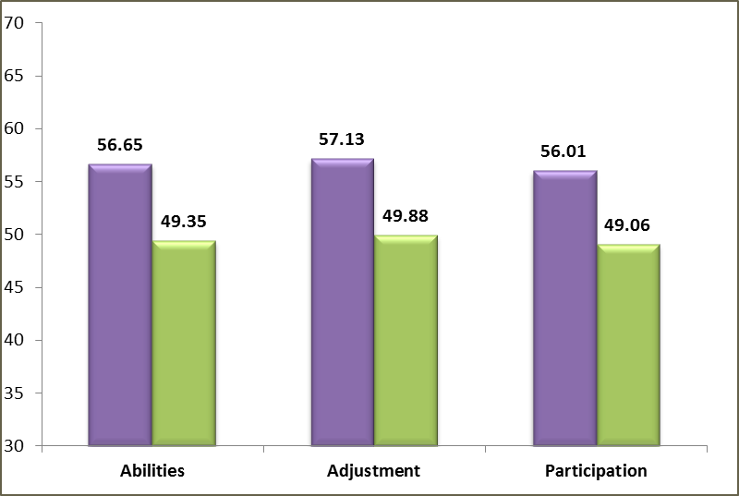
Treatment Efficacy
Reduce disability over time. This graph shows that lower scores are achieved with neurorehabilitation.
Program Type:
Neurorehabilitation
(N = 2,006)
Abilities [t(2005) = 43.4, p<.001]; Adjustment [t(2005) = 38.6, p<.001];
Participation [t(2005) = 43.2, p<.001].

Slide 35
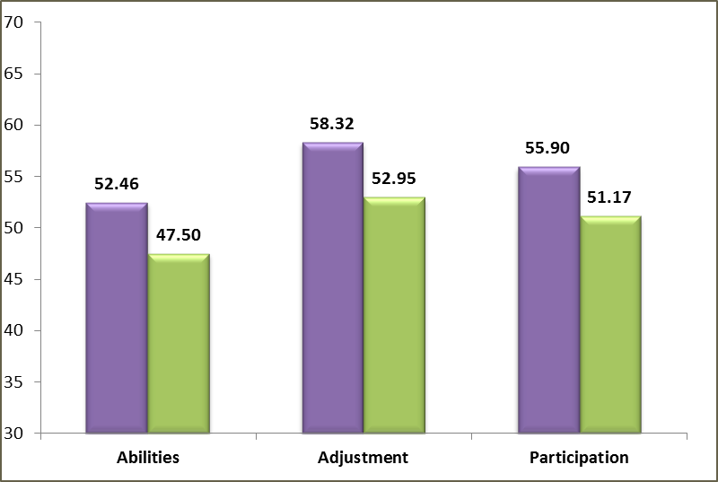
Treatment Efficacy
Reduce disability over time. This graph shows that lower scores are achieved with neurobehavioral intense persons.
Program Types:
Neurobehavioral
(N = 333)
Abilities [t(332) = 12.0, p<.001]; Adjustment [t(332) = 11.5, p<.001];
Participation [t(332) = 12.1, p<.001].

Slide 36
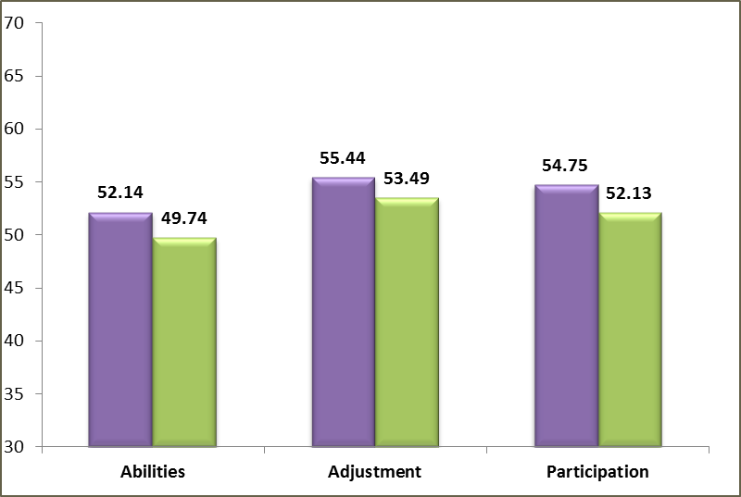
Treatment Efficacy
Reduce disability over time. This graph shows that lower scores are achieved with supported living environments focusing on health, safety, and quality of life.
Program Types:
Supported Living
(N = 395)
Abilities [t(394) = 4.9, p<.001]; Adjustment [t(394) = 4.1, p<.001];
Participation [t(394) = 6.8, p<.001].

Slide 37
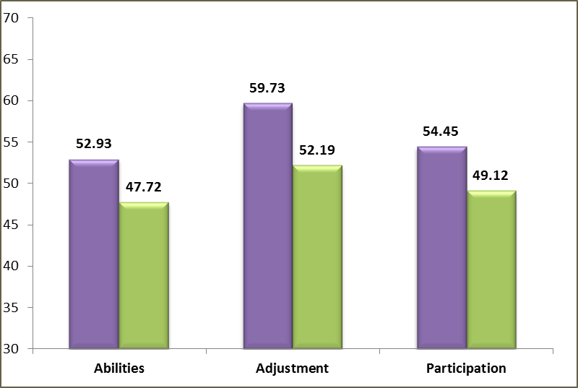
Treatment Efficacy
Reduce disability over time. This graph shows that lower scores are achieved with pediatrics/ adolescents with and with behavioral intensity.
Program Types:
Adolescent Intensive
(N = 183)
Abilities [t(182) = 8.9, p<.001]; Adjustment [t(182) = 12.6, p<.001];
Participation [t(182) = 11.6, p<.001].

Slide 38
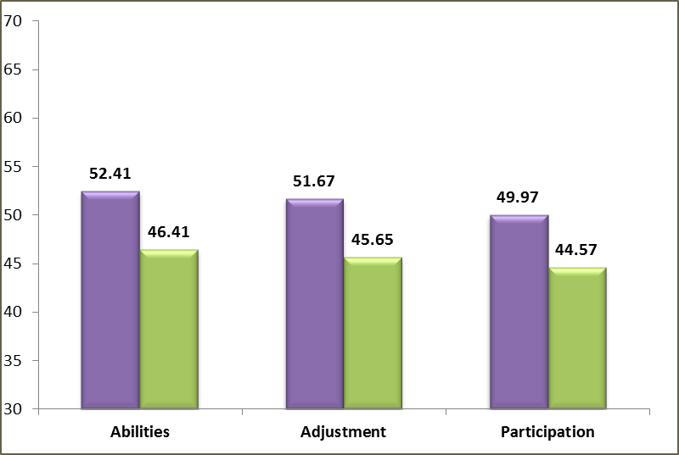
Treatment Efficacy
Reduce disability over time. This graph shows that lower scores are achieved with a day treatment focus.
Program Types:
Day Treatment
(N = 517)
Abilities [t(516) = 15.9, p<.001]; Adjustment [t(516) = 14.6, p<.001];
Participation [t(516) = 16.9, p<.001].

Slide 39
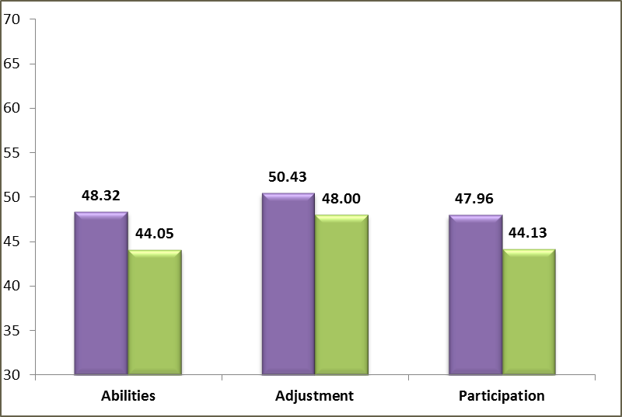
Treatment Efficacy
Reduce disability over time. This graph shows that lower scores are achieved at the outpatient level.
Program Types:
Outpatient
(N = 55)
Abilities [t(54) = 6.5, p<.001]; Adjustment [t(54) = 6.3, p<.001];
Participation [t(54) = 6.5, p<.001].

Slide 40
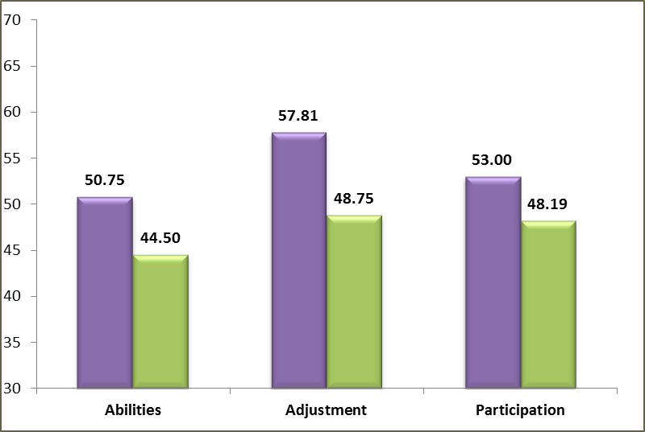
Treatment Efficacy
Reduce disability over time. This graph shows that lower scores are achieved at the home and community integration level.
Program Types:
Home & Community
(N = 15)
Abilities [t(14) = 2.4, p<.03]; Adjustment [t(14) = 2.5, p<.02];
Participation [t(14) = 2.7, p<.02].

Slide 41
Modeling Outcomes

Slide 42
Treatment Model of Care – Rasch Analysis
Audition
Dizziness
Motor Speech
Pain/Headache, Vision, Use of Hands
--
Inappropriate Social, Irritability, Symptom Sensitivity
Depression, Fund of Information, Visual Perception
Anxiety, Fatigue, Mobility, Non-Verbal Communication, Verbal Communication
--
Self-Care
Family Function
--
Initiation, Productivity
Attention, Impaired Awareness, Memory
Novel Problem Solving, Social Contact
--
Leisure and Recreation
Money Management
Home Skills
Transportation Use

Slide 43
Efficacy

Slide 44
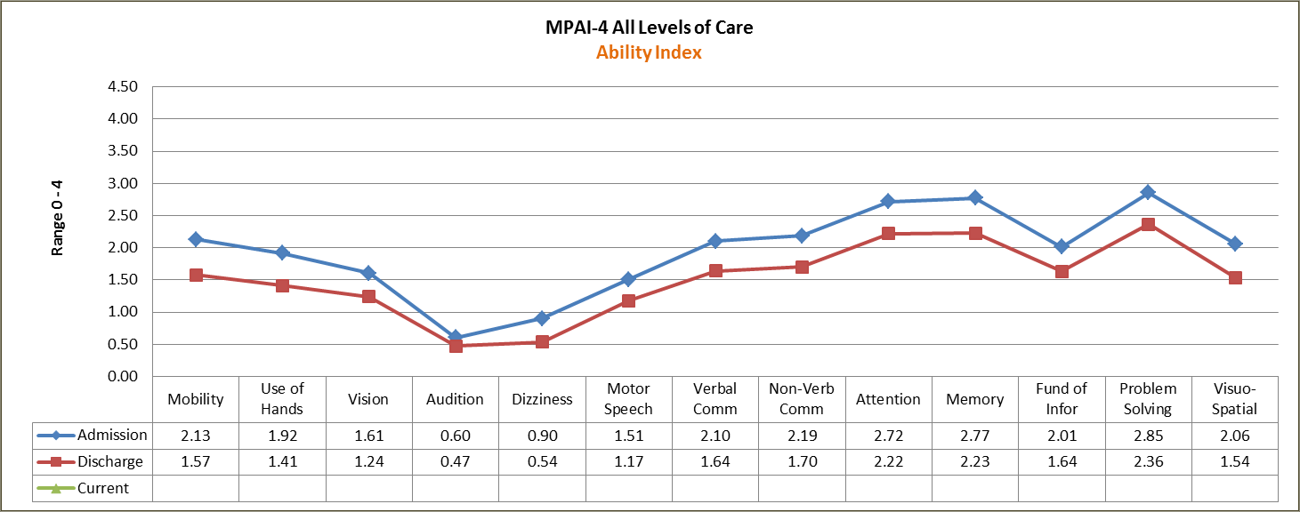
Treatment Efficacy
The efficacy of care has to be demonstrated to show that gains can be made.
Considerations of Efficacy…
Application of skills to real-world context.

Slide 45
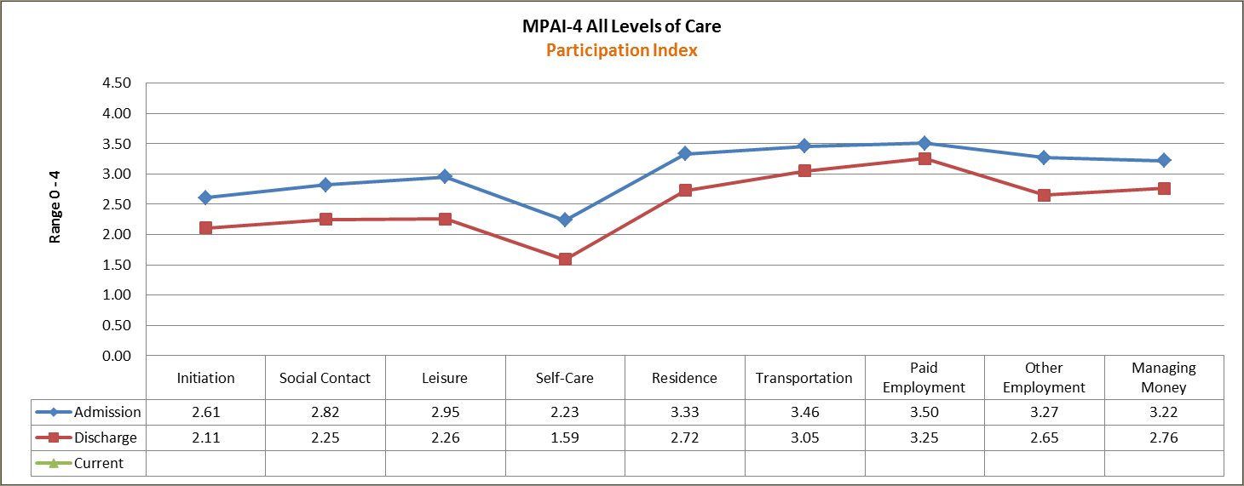
Treatment Efficacy
The efficacy of care has to be demonstrated to show that gains can be made.
Considerations of Efficacy…
Application of skills to real-world context.

Slide 46
Treatment Efficacy
Targeted Interventions
Improved functional outcomes for community living.

Slide 47
Treatment Efficacy
Targeted Interventions
Research has demonstrated that Initiation, Self-Care skills and Home Skills are the key ingredients to all levels of care. Combined, these elements account for 45% of outcome in post-hospital care.
For long-term care, these skills are essential to healthy living and continue to work the brain in a capacity that reduces care cost (e.g., lower cost of supervision, greater focus toward independence).
Lewis & Horn, 2019

Slide 48
Treatment Efficacy – Targeted Interventions
Initiation
Problem Solving
(20% of Variance)
Mobility
(5% of Variance)
Fund of Information/
Attention
(2% of Variance)
Non-Verbal Communication
(3% of Variance

Slide 49
Treatment Efficacy – Targeted Interventions
Self-Care (ADLs)
Mobility
(34% of Variance)
Non-Verbal Communication
(2% of Variance)
Fund of Information
(5% of Variance)
Use of Hands
(3% of Variance)

Slide 50
Treatment Efficacy – Targeted Interventions
Home Skill
Mobility
(21% of Variance)
Problem Solving
(9% of Variance)
Use of Hands
(1% of Variance)
Fund of Information
(2% of Variance)

Slide 51
Treatment Efficacy
The efficacy of care has to be demonstrated to show that gains can be made.
Considerations of Efficacy…
Prevention of decline through the aging process.

Slide 52
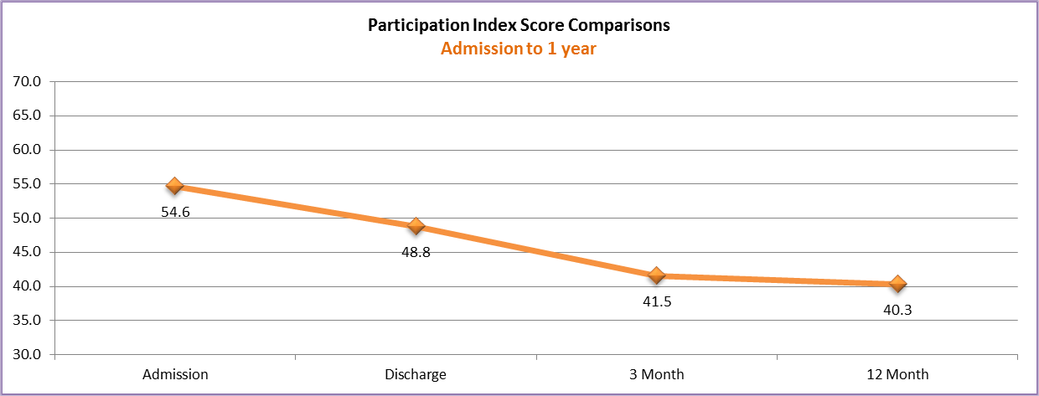
Treatment Efficacy – Prevention
Goal: an individual will continue to maintain their gains; the graph demonstrates that phenomenon with appropriate care for the appropriate length of time.

Slide 53
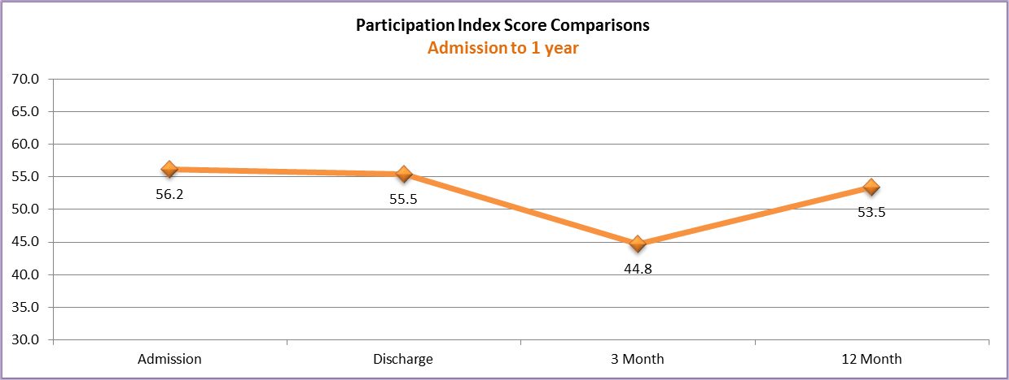
Treatment Efficacy – Prevention
Goal: Individuals that are greater than 4 years post injury typically require ongoing supports and services, and tend to do better with continued structure. Without the structure and support, the individuals are at risk for decline in function (in this graph, higher score indicates greater disability)

Slide 54
Research and Analytics
Finding new things.

Slide 55
Research References
Harding, V., O’Donoghue, C., Meixner, C., Lewis, F., Horn, G. & Russell, R. (2017). Post-acute traumatic brain
injury rehabilitation treatment variables: A mixed methods study. Clinical Archives of
Communication Disorders, 2(3), 209-2013.
Horn, G.J., Lewis, F.D. & Pepitone, J. (2017). Clinical challenges of craniopharyngioma: Neurobehavioral sequelae
and complex outcomes. Neurological Disorders and Therapeutics, 1(2): 1-5.
Horn, G.J., Lewis, F.D., Russell, R. & Kemp, D. (2017). Anxiety following traumatic brain injury: Impact on post
-hospital rehabilitation outcomes. Physical Medicine & Rehabilitation Research, 2(4), 1-6.
Horn, G.J. & Lewis, F.D. (2016). Behavioral Dyscontrol following acquired brain injury: Effectiveness of post
-hospital neurobehavioral intensive programs. Journal of Neurology & Neuromedicine, 1(8), 29-33.
Horn, G.J. & Lewis, F.D. (2014). A model of care for neurological rehabilitation. AANLCP – Journal of Nurse Life
Care Planning, 14 (3), 681-691.
Lewis, F.D. & Horn, G.J. (2018). Traumatic brain injury and Cerebrovascular Accident: Applications of Rasch
Analysis to examine differences in disability and outcome in post-hospital rehabilitation. Open
Journal of Statistics, 8, 670-683.
Lewis, F.D. & Horn, G.J. (2017). Rasch Analysis and Functional Measurement in Post-hospital brain injury
rehabilitation. International Journal of Statistics and Probability, 6(6), 1-10.

Slide 56
Research References
Lewis, F.D., Horn, G.J & Russell, R. (2017). Impact of chronicity on outcomes following post-hospital residential
brain injury rehabilitation: Application of multivariate statistics and Rasch Analysis. Open Journal of
Statistics, 7, 254-263.
Lewis, F.D., Horn, G.J., & Russell, R. (2017). Examination of post-hospital residential brain injury rehabilitation
outcomes across the age spectrum. International Journal of Physical Medicine & Rehabilitation, 5
(1), 1-6.
Lewis, F.D. & Horn, G.J. (2016). Depression following traumatic brain injury: Impact on Post-hospital residential rehabilitation outcomes. NeuroRehabilitation. Accepted October 2016 for publication in Spring of
2017.
Lewis, F.D. & Horn, G.J. (2015). Neurologic Continuum of Care: Evidence-based model of post-hospital system of
care. NeuroRehabilitation (36), 243-251.
Lewis, F.D. & Horn, G.J. (2013). Traumatic Brain Injury: Analysis of functional deficits and post-hospital
rehabilitation outcomes. Journal of Special Operations Medicine, 13 (3), 56-61.
Vaughan, A, Horn, G.J., & Lewis, F.D. (2018). Impact of diabetes on outcomes for persons with chronic brain
injury. Journal of Neurology and Neurobiology, 4(2), 1-5.

Slide 57
Published Abstracts
Horn, GJ & Lewis, FD (2013). Analysis of Post-Hospital Neurological Rehabilitation Outcomes (abstract). The
Journal of Head Trauma Rehabilitation, 28 (5), 25 (#0057).
Horn, G.J. & Lewis, F.D. (2014). Functional impact of anxiety on traumatic brain injury outcomes. Presented
to the 91st American Congress of Rehabilitation Medicine, October 2014, Toronto, Canada.
Abstract published in Archives of Physical Medicine & Rehabilitation.
Horn, G.J., Lewis, F.D., Kincaid, K.J., & Russell, R. (2017). The impact of post-hospital stroke rehabilitation on
disability reduction and quality outcomes. [Abstract]. Archives of Physical Medicine &
Rehabilitation.
Horn, G.J., Lewis, F.D., & Malec, J (2016). Rehabilitation Modeling: Using the Rasch Analysis for evidenced
-based care. Archives of Physical Medicine and Rehabilitation.

Slide 58
National & International Presentations
Horn. G.J. & Lewis, F.D. (2013). Analysis of post-hospital neurological rehabilitation outcomes. Paper presented
to the North American Brain Injury Society (NABIS) Annual Meeting, September 20, 2013
Technology Lecture Series.
Horn, G.J. & Lewis, F.D. (2014). Functional impact of anxiety on traumatic brain injury outcomes. Presented at
the 91st American Congress of Rehabilitation Medicine, October 2014, Toronto, Canada. Published
abstract in the Archives of Physical Medicine and Rehabilitation.
Horn, G.J., Lewis, F.D., Russell, R., & Harding, V. (2014). Pediatric Neurorehabilitation: post-hospital outcome
comparisons. Submission accepted by World Congress 2014 for paper presentation. Brain Injury.
Horn, G.J. (2015). Translational Neurorehabilitation Outcomes: Research trends and person-centered care.
Presented to the Defense and Veterans Brain Injury Center. International WebEx Presentation.
June 11, 2015. Provision of 1.5 hours of continuing medical, psychological, and rehabilitation
education credits. Defense Centers of Excellence for Psychological Health and Traumatic Brain
Injury.
Horn, G. J. Lewis, F.D. Malec, J., Papadimitriou, C., Kersten, P., O’Donoghue, C.R., Meixner, C. Harding, V., Russell, R.
(2015). Diversity of Outcomes: From person-centered to international neurorehabilitation perspectives.
4 – hour course presented at the American Congress of Rehabilitation Medicine, October 2015, Dallas, TX,
United States. Published abstract in the Archives of Physical Medicine and Rehabilitation.

Slide 59
National & International Presentations
Horn, G. J. Lewis, F.D. Malec, J., Papadimitriou, C., Kersten, P., O’Donoghue, C.R., Meixner, C. Harding, V., Russell,
R. (2019). Diversity of Outcomes: From person-centered to international neurorehabilitation
perspectives. 4 hour Workshop presented at the American Congress of Rehabilitation Medicine,
October 2019, Chicago, IL, United States. Published abstract in the Archives of Physical Medicine
and Rehabilitation.
Horn, G.J., Lewis, F.D., & Malec, J (2016). Rehabilitation Modeling: Using the Rasch Analysis for evidenced-based
care. Instructional Course at the 93rd American Congress of Rehabilitation Medicine Annual
Meeting, Chicago, Illinois (November 3, 2016).
Horn, G.J., Lewis, F.D., Kincaid, K.J., & Russell, R. (2017). The impact of post-hospital stroke rehabilitation on
disability reduction and quality outcomes. American Congress of Rehabilitation Medicine 94th
Annual Meeting, Atlanta, Georgia (October 24, 2017).
Lewis, F.D. & Horn, G.J. (2013). Functional impact of depression on traumatic brain injury outcomes. Presented
at the Special Operations Medicine Conference (December), Tampa, Florida.
Lewis, F.D. & Horn, G.J. (2014). Post-hospital Brain Injury Rehabilitation: Comparison of neurobehavioral intensity and neurorehabilitation outcomes. Submitted and accepted for the 91st American
Congress of Rehabilitation Medicine, October 2014, Toronto, Canada.
Russell, R., Horn, G.J., Lewis, F.D., & Harding, V. (2014). Pediatric neurorehabilitation: post-hospital outcomes
comparisons. Paper presented at 2014 Research Symposium for Master’s in Public Health, Benedictine
University, College of Education and Health Services, Lisle, Ill.

Slide 60
Questions
?
Gordon J. Horn, PhD
National Deputy Director of Clinical Outcome Services
gordon.horn@neurorestorative.com

Slide 61
BREAK

Slide 62
Indiana Snapshot Lance Trexler, PhD, FACRM Judy Reuter

Slide 63
Indiana Snapshot for ACL Grant
Who is our target audience?
Funding Sources
State Agencies
Community Partners
Payors

Slide 64
What story do we want to tell?
Indiana is focused on building systems of support via a community integrated model of service delivery for persons with TBI.
Report on prevalence of TBI in the following settings:
Mental Health & Substance Abuse
Criminal Justice
Homelessness
Educational systems (Schools)
Vocational

Slide 65
How will we tell the story?
Sourced and evidence-based data.
Develop copy to provide context to the data and tie the overall story together.
Design and organize graphs and data visually to guide the audience from beginning to end.
Simple design with focus on the story with accurate data.
Possibly interactive; ie online and PPT.

Slide 66
ACL Timeline: Disseminate by Sept 2019 How will we disseminate?
Print
Electronic (pdf)
Listservs
Press Release

Slide 67
New ACL Product: Best Practices Guideline for TBI in the Criminal Justice System Lance Trexler, PhD, HSPP, FACRM

Slide 68
Indiana ACL TBI Grant
Indiana was designed by ACL as one of three Mentor States in TBI and Criminal Justice
Designation for Mentor State was based on Research and Program – System development in TBI and the Criminal Justice System
Through the ACL grant, established a TBI – Criminal Justice Workgroup

Slide 69
What We Know
60% of all individuals in the criminal justice system screen positive for TBI (Veterans 68% for moderate to severe)
Incarcerated Survivors of TBI:
Commit a far greater number of conduct violations and infractions.
Experience greater barriers to treatment
Are often mistaken as noncompliant.
When engaged in therapy, require 2-3X the amount of services to achieve success
Are almost twice as likely to be re-arrested within their first year of release
3X more likely to misuse substances and 11X more likely to die of an opioid overdose.

Slide 70
Adolescent TBI and Crime
508 psychiatric inpatient adolescents
Adolescents with TBI had significantly more often committed crimes (53.8%) compared to adolescents without TBI (14.7%)
Subjects with TBI had significantly more violent crimes
TBI during childhood and adolescence increased the risk of:
any criminality 6.8-fold (95% 3.0–15.2),
conduct disorder 5.7-fold (95% 2.1–15.4). and
concomitant criminality and conduct disorder 18.7-fold (95% 4.3–80.1)
Luukkainen, S, Riala, K, Laukkanen, M et al (2012). Association of traumatic brain injury with criminality in adolescent psychiatric inpatients from Northern Finland. Psychiatry Research, 200, 767-772

Slide 71
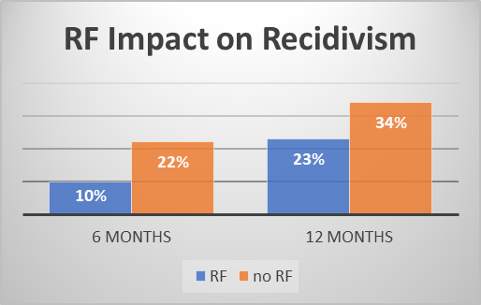
Effects of TBI on IDOC
TBI negatively impacts one’s ability to engage and participate effectively in treatment/programs (e.g., impaired memory and learning job skills or staying on track)
If offenders with TBI are not being identified or treated, will likely lead to unsuccessful rehabilitation/programming, failed community re-entry, and costly recidivism

Slide 72
ACL TBI-Criminal Justice Best Practice Guidelines
DOC Training and Education
Screening for Lifetime Exposure to TBI
Screening for Impairment
Accommodations for TBI
a. DOC
b. Medical-Behavioral Health Providers
Referral on Release to TBI Resources and Supports

Slide 73
Discussion and Recommendations

Slide 74
Adjournment

Slide 75
Disclosures
Funding for this presentation was made possible (in part) by the Administration for Community Living. The views expressed in written conference materials or publications and by speakers and moderators do not necessarily reflect the official policies of the Department of Health and Human Services, nor does the mention of trade names, commercial practices, or organizations imply endorsement by the U.S. Government.

